Slide 1
CONFIDENTIAL • SEO AUDIT REPORT
REFLECTORN
Complete SEO Audit & Strategic Action Plan
www.reflectorn.com.au
PREPARED
May 2026
INDUSTRY
Cosmetic Injectables
LOCATION
Fairfield, VIC, Australia

Slide 2
Table of Contents
What this audit covers
01
Executive Summary
Headline findings & overall site health score
02
Site Overview & Methodology
Audit scope, tools used, and data sources
03
Technical SEO
Crawlability, indexation, robots, sitemap, redirects
04
On-Page SEO
Titles, meta descriptions, headings, content depth
05
Site Speed & Core Web Vitals
Mobile and desktop performance analysis
06
Content Quality & AI Risk
Content audit and AI-generated content detection
07
Backlink Profile Analysis
Link quality, toxic links, disavow recommendations
08
Keyword & Ranking Performance
Organic visibility and opportunities
09
Local SEO
Google Business Profile, NAP, citations, schema
10
Prioritised Action Plan
30/60/90 day roadmap with expected impact
ReflectorN SEO Audit | May 2026
Contents
2

Slide 3
Executive Summary
Overall site health and headline findings
OVERALL SITE HEALTH
25
3
81
50
D+
Organic Keywords
Domain Rating
Monthly Traffic
Mobile PSI
Very low
Weak
Critical
Failing
100+
5.0★
60+
5
Needs Urgent Attention
Toxic Backlinks
Google Reviews
Indexed Pages
Schema Items
Critical issues found in
4 of 10 audit categories
Disavow!
Excellent
OK
Good
VERDICT:
The site has strong local presence and brand reputation (5★ reviews, complete Google Business Profile, validated schema), but suffers from critical technical issues, toxic backlinks, AI-generated content risk, and poor mobile performance. Without intervention, organic visibility will continue to stagnate or decline.
ReflectorN SEO Audit | May 2026
Executive Summary
3

Slide 4
Top 5 Critical Issues
The most urgent problems requiring immediate action
01
Toxic Backlink Profile
FIX: Compile and submit disavow file via GSC
100+ spammy PBN-style backlinks from unrelated domains (movie sites, music sites, fake SEO directories). High Google penalty risk.
02
AI-Generated Content Detected
FIX: Rewrite top blog posts with practitioner expertise
Ahrefs flags 4 of 7 traffic-driving pages as 'Very High' AI content. For YMYL (medical), this is a major E-E-A-T risk.
03
Mobile Performance Score: 50/100
FIX: Compress images, convert to WebP, lazy-load
Multi-megabyte images (2.4MB, 2.3MB, 1.9MB) crash Core Web Vitals. No CrUX data — too few real users.
04
Metadata Issues on 48+ Pages
FIX: Rewrite all titles and meta descriptions
26 pages with broken/short/long titles. 22 pages with duplicate or oversized meta descriptions. Typos ('Marrionettes').
05
Thin Content on Service Pages
FIX: Expand to 800-1500 words with full treatment info
7 indexable pages with <160 words including service pages and Before/After gallery (83 words). Cannot rank for commercial intent.
ReflectorN SEO Audit | May 2026
Critical Issues
4

Slide 5
Site Overview & Audit Methodology
What we analysed and which tools were used
SITE PROFILE
TOOLS USED
Domain
reflectorn.com.au
Screaming Frog SEO Spider
Site crawl, on-page audit, metadata
Platform
Wix
Ahrefs
Backlinks, keywords, AI content scoring
Business Type
Cosmetic Injectables Clinic
SEMrush
Cross-validation, authority score
Owner / Practitioner
Sunny (Registered Nurse — RN1)
PageSpeed Insights
Core Web Vitals (Mobile + Desktop)
Physical Address
145C Station St, Fairfield VIC 3078
Schema.org Validator
Structured data verification
Phone
+61 0477 781 442
Google Search / Maps / GBP
Indexation, local citations
Total Pages Crawled
67 internal URLs
Chrome DevTools
Mobile rendering, responsive QA
Service Areas
Fairfield, Northcote, Brunswick
Manual Inspection
Robots, sitemap, content review
ReflectorN SEO Audit | May 2026
Methodology
5

Slide 6
SECTION 03
Technical SEO
Crawlability, indexation, redirects & site architecture
ReflectorN SEO Audit | May 2026
TECHNICAL SEO
6

Slide 7
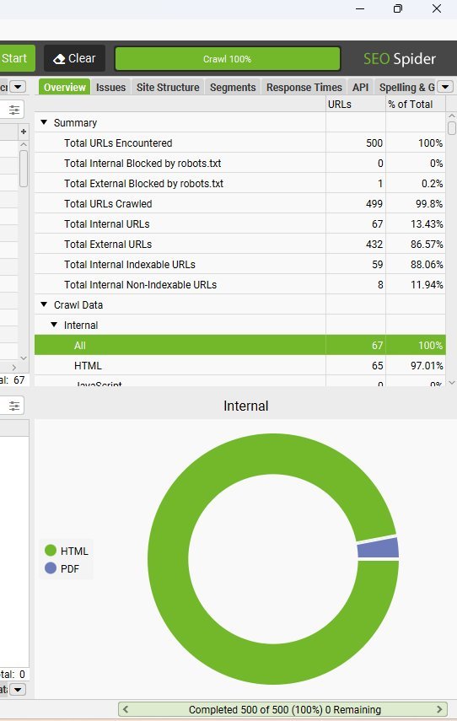
Site Crawl Overview
Snapshot from Screaming Frog SEO Spider
PASSING
Crawl Statistics
Total URLs
500
Internal URLs
67
Indexable
59 (88%)
Non-Indexable
8 (12%)
5xx Errors
0 ✓
Blocked by robots
0 ✓
VERDICT
Crawl is clean. No server errors, no blocking issues. Small but manageable site footprint typical of a single-location clinic.
ReflectorN SEO Audit | May 2026
Technical SEO
7

Slide 8
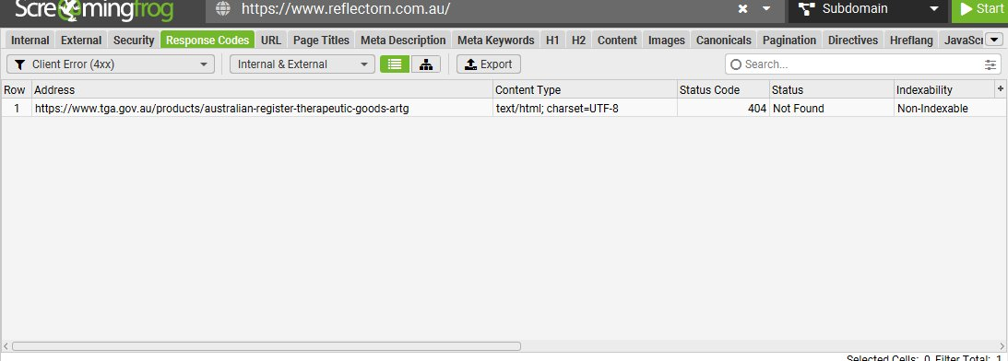
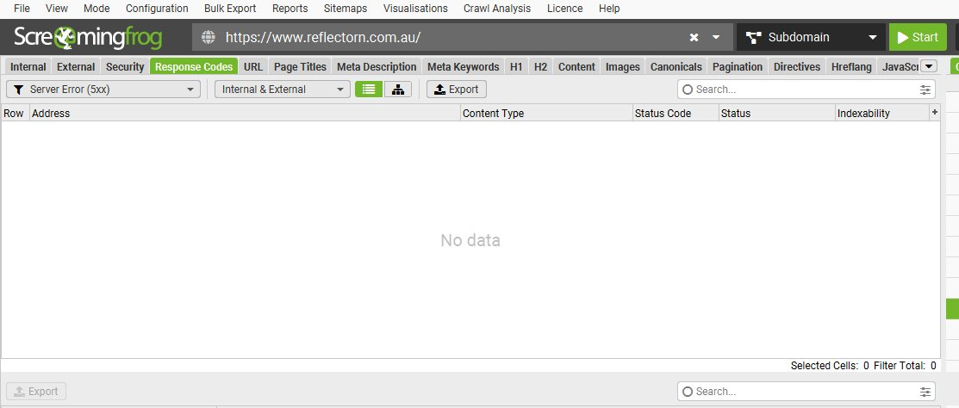
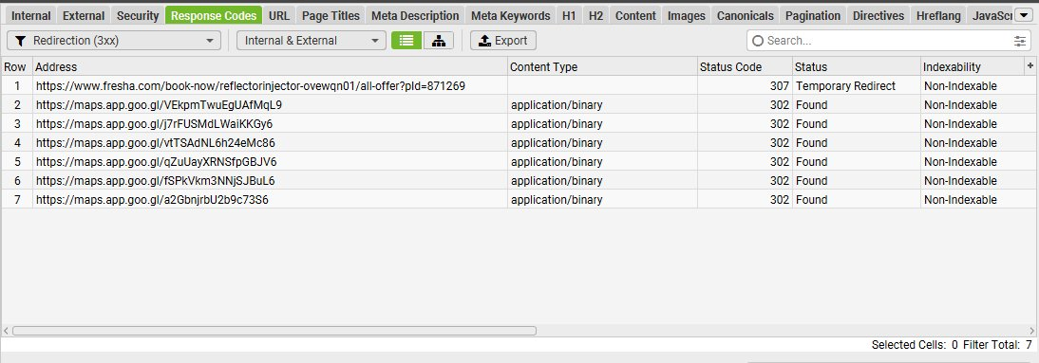
Response Codes & Redirects
HTTP status code health check
4xx Errors (Broken Links)
5xx Server Errors
3xx Redirects
1 found
0 found
7 found
Outbound link to TGA.gov.au (404). Update or remove citation.
Server is stable. No infrastructure issues detected.
All redirects are external (Google Maps, booking widgets). Normal.
ReflectorN SEO Audit | May 2026
Technical SEO
8

Slide 9
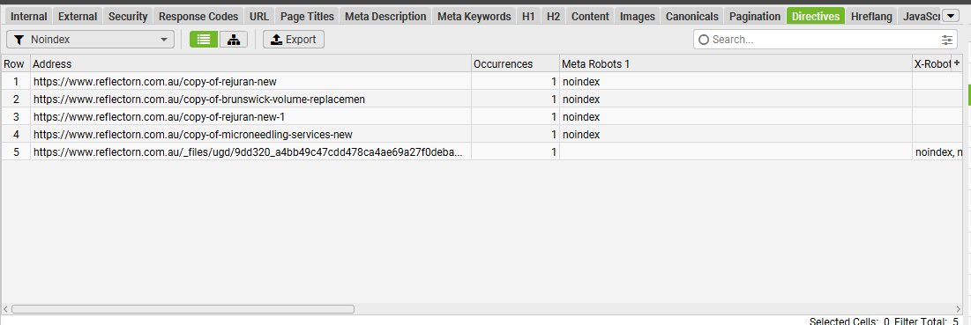
Indexation Issues
5 'copy of' draft pages found on the live site
HIGH
What we found
5 pages with noindex directive on the live site:
/copy-of-rejuran-new
/copy-of-rejuran-new-1
/copy-of-brunswick-volume-replacement
/copy-of-microneedling-services-new
1 noindexed PDF asset
While noindex is correctly applied, these draft pages waste crawl budget and indicate poor site hygiene.
RECOMMENDED ACTION
Delete all 'copy-of' pages from the Wix dashboard. They serve no purpose to users and clutter the crawl.
ReflectorN SEO Audit | May 2026
Technical SEO
9

Slide 10
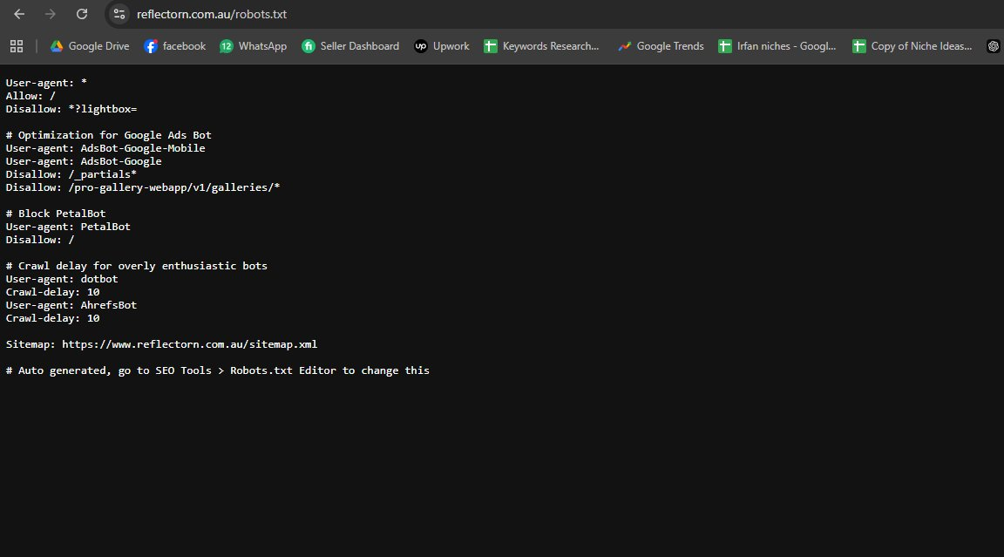
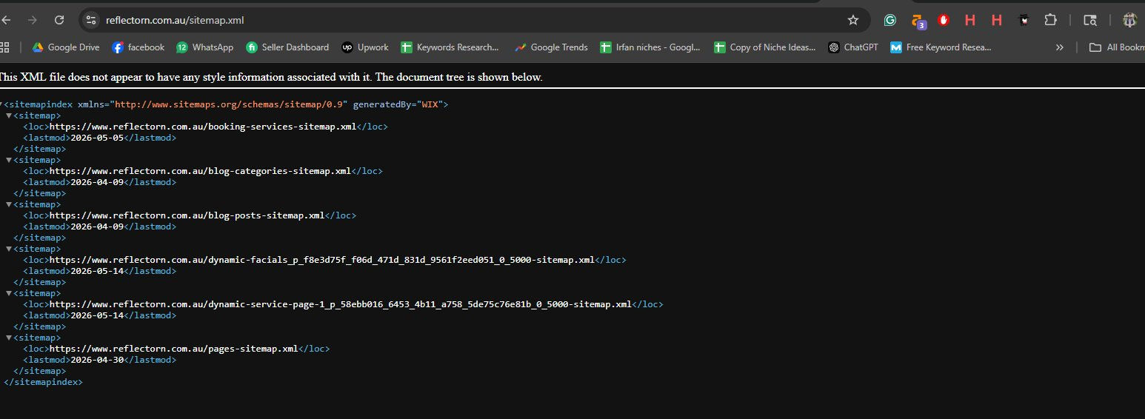
Robots.txt & XML Sitemap
Crawl directives review
LOW
PASSING
ROBOTS.TXT
XML SITEMAP
✓ Sitemap correctly referenced
✓ Wix defaults properly configured
⚠ AhrefsBot crawl-delay = 10 sec (limits analysis tools)
⚠ PetalBot fully blocked (Huawei search)
✓ Sitemap index with 6 sub-sitemaps
✓ Auto-generated by Wix, kept fresh (May 2026)
✓ Covers blogs, services, categories
→ Submit to GSC once access is obtained
ReflectorN SEO Audit | May 2026
Technical SEO
10

Slide 11
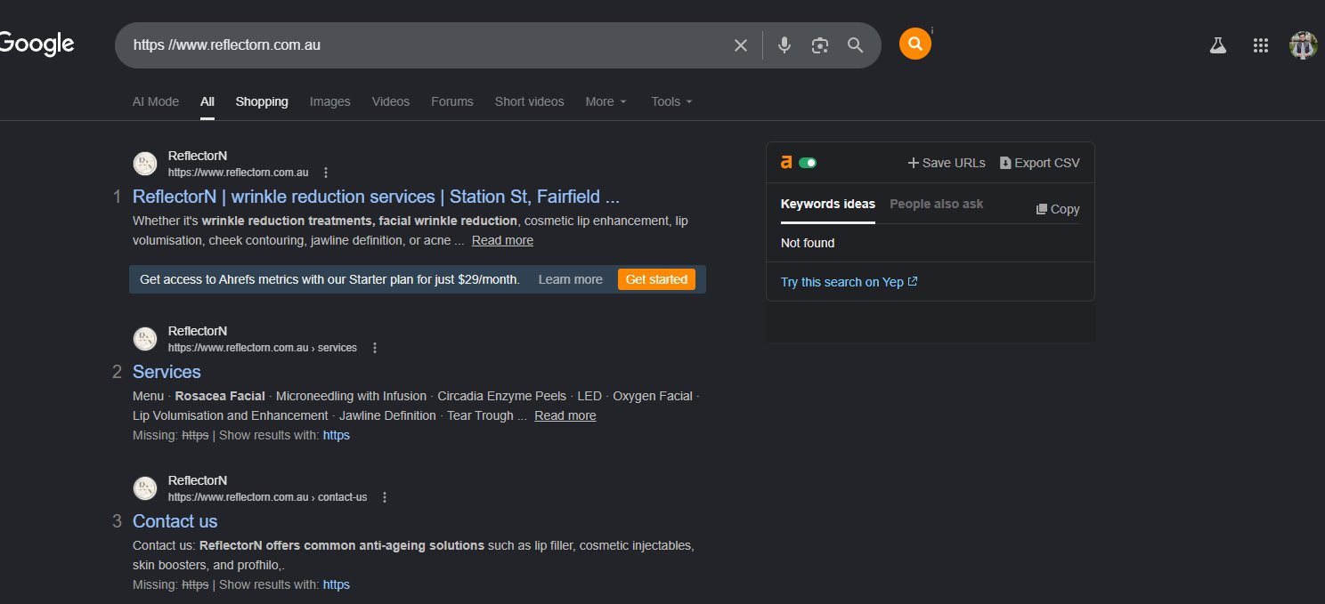
HTTPS & Canonical Tag Audit
Mixed signals detected in SERP rendering
HIGH
Issue Detected
Google shows the message:
"Missing: https | Show results with: https"
...beneath several inner-page results.
This suggests Google has indexed BOTH http:// and https:// versions of some pages — a canonical confusion problem that splits ranking signals.
RECOMMENDED ACTION
Verify Wix SSL settings enforce https://www. Test all 4 URL variants. Request re-indexing in GSC.
ReflectorN SEO Audit | May 2026
Technical SEO
11

Slide 12
SECTION 04
On-Page SEO
Titles, meta descriptions, headings & content depth
ReflectorN SEO Audit | May 2026
ON-PAGE SEO
12

Slide 13
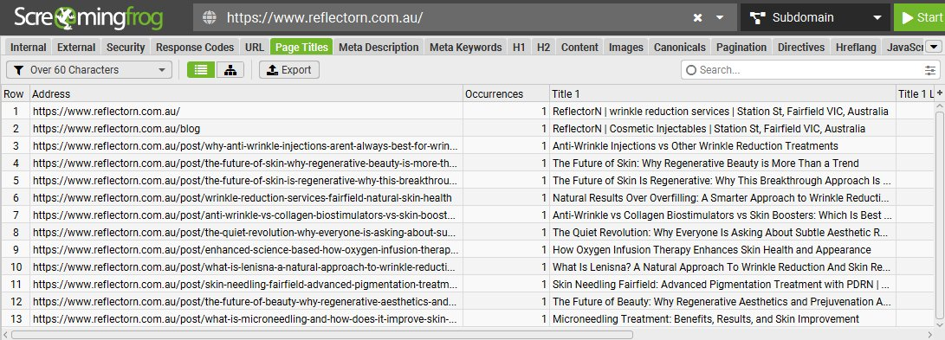
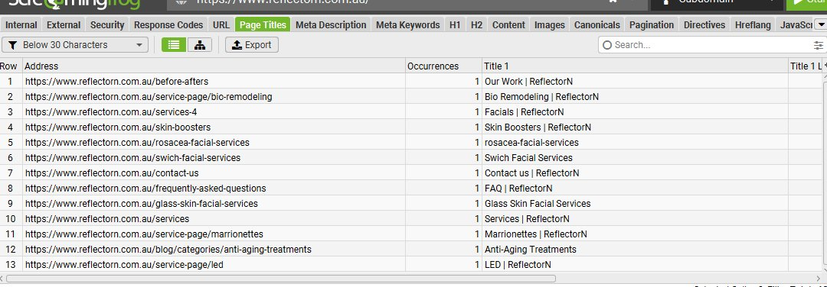
Title Tag Issues — 26 Pages Affected
Long, short, weak, and misspelled titles found
HIGH
HIGH
TITLES TOO LONG (13 pages)
TITLES TOO SHORT / WEAK (13 pages)
Homepage title: 78 chars — truncated in SERPs
11 blog posts also exceed 60 character limit
TYPO: 'Marrionettes' (should be 'Marionettes')
TYPO: 'Swich Facial' (should be 'SWiCH Facial')
Missing location 'Fairfield' from service titles
ReflectorN SEO Audit | May 2026
On-Page SEO
13

Slide 14
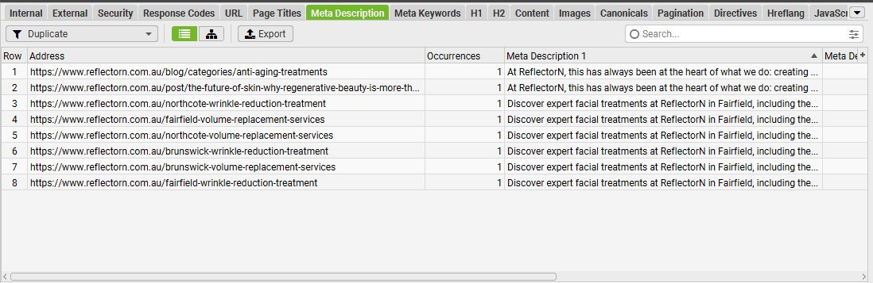
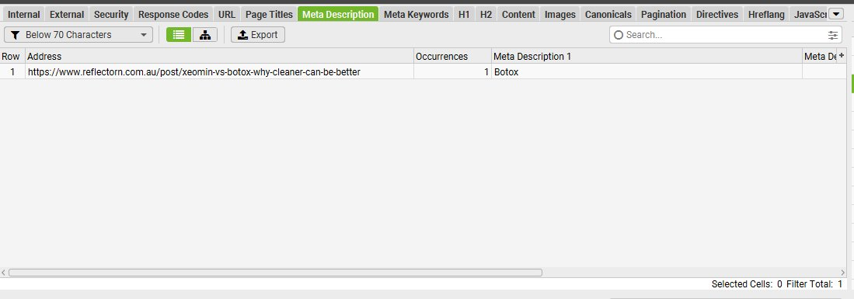
Meta Description Issues — 22 Pages Affected
Duplicates, oversized, and one-word descriptions
HIGH
CRITICAL
DUPLICATE META DESCRIPTIONS (8 pages)
CRITICAL ANOMALY DETECTED
5 location pages (Northcote/Fairfield/Brunswick) share IDENTICAL meta descriptions despite targeting different cities.
/post/xeomin-vs-botox-why-cleaner-can-be-better
Meta description = just one word: "Botox"
ReflectorN SEO Audit | May 2026
On-Page SEO
14

Slide 15
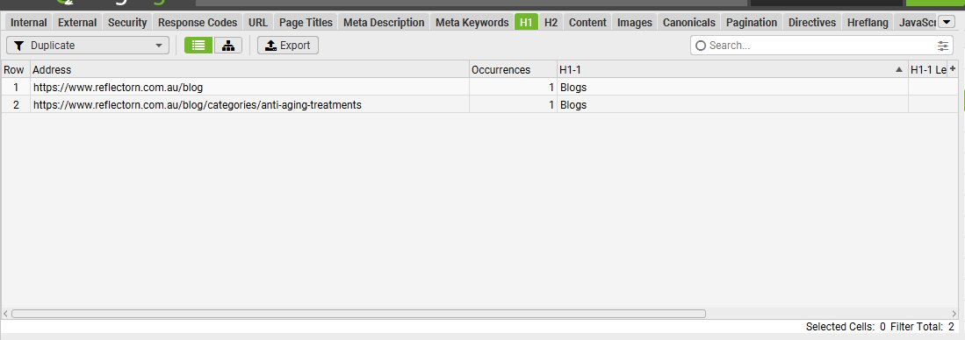
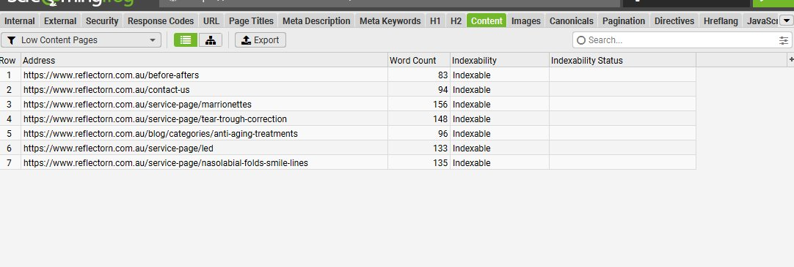
H1 Headings & Thin Content
Heading structure and word count audit
MEDIUM
HIGH
DUPLICATE H1s
THIN CONTENT PAGES (7 pages, all indexable)
Both /blog and /blog/categories/anti-aging-treatments use generic H1 = "Blogs"
Generic non-descriptive H1 wastes SEO real estate
CRITICAL OBSERVATION
Service pages with <160 words cannot rank for commercial keywords. Industry standard for cosmetic clinics is 800–1500 words per service page.
ReflectorN SEO Audit | May 2026
On-Page SEO
15

Slide 16
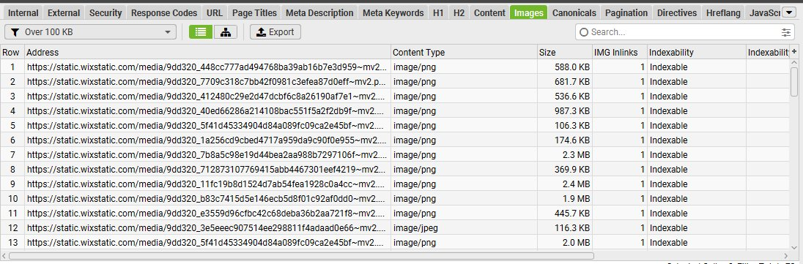
Image Optimization Crisis
Multi-megabyte images crippling site performance
CRITICAL
Severity of Problem
2.4 MB
Largest single image — should be under 200KB
13+ images
Over 100KB — many over 500KB and 1MB
Missing alt text
Many images have no alt text (accessibility + SEO loss)
THE FIX
Compress all images to <200KB. Convert to WebP/AVIF. Add descriptive alt text. Enable lazy loading.
ReflectorN SEO Audit | May 2026
On-Page SEO
16

Slide 17
SECTION 05
Site Speed
Core Web Vitals & PageSpeed performance
ReflectorN SEO Audit | May 2026
SITE SPEED
17

Slide 18
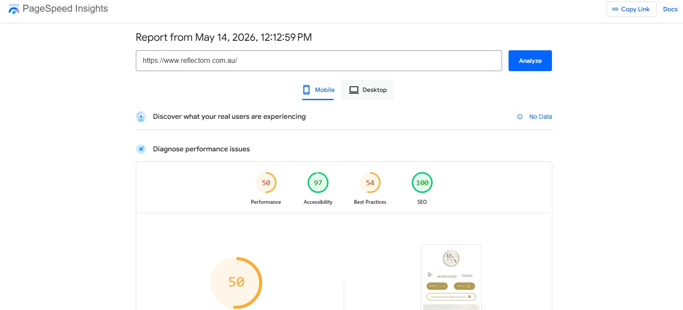
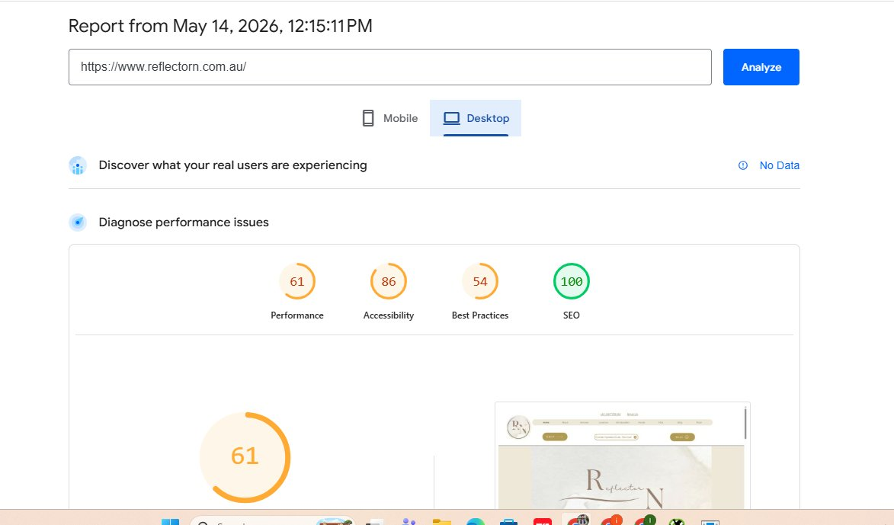
PageSpeed Insights Results
Both mobile and desktop scores need improvement
CRITICAL
HIGH
MOBILE
DESKTOP
Performance: 50
Accessibility: 97 ✓
Best Practices: 54
SEO: 100 ✓
Performance: 61
Accessibility: 86
Best Practices: 54
SEO: 100 ✓
ReflectorN SEO Audit | May 2026
Site Speed
18

Slide 19
Core Web Vitals — No Real-User Data
The site has insufficient traffic for CrUX measurement
LCP
INP
CLS
—
—
—
Largest Contentful Paint
Likely 4s+ on mobile due to heavy images
Interaction to Next Paint
No data — too few users
Cumulative Layout Shift
Likely affected by chat widgets
WHY THIS MATTERS
Google's CrUX dataset shows "No Data" for ReflectorN — meaning fewer than the threshold number of real users visit the site each month to generate Field Data.
This has two implications:
1. The site likely doesn't pass Google's Page Experience signal, hurting rankings.
2. Once traffic grows (via the fixes in this audit), Field Data will populate — be ready to act on it.
ReflectorN SEO Audit | May 2026
Site Speed
19

Slide 20
SECTION 06
Content Quality & AI Risk
The biggest hidden threat to your rankings
ReflectorN SEO Audit | May 2026
CONTENT QUALITY & AI RISK
20

Slide 21
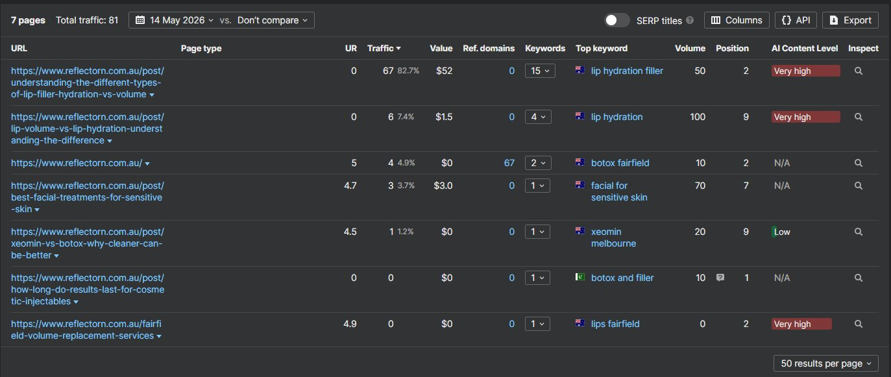
AI-Generated Content Detected
Ahrefs flags 4 of 7 traffic-driving pages as 'Very High' AI content
CRITICAL
The Problem
The top traffic page (67 visits/mo, 82% of all traffic) is flagged VERY HIGH AI content.
For a cosmetic medical clinic, this is YMYL (Your Money or Your Life) territory — Google specifically scrutinises medical content for E-E-A-T.
Risks:
Helpful Content Update penalties
Sudden ranking drops
Loss of medical authority signals
URGENT FIX
Rewrite blog posts with Sunny RN's real expertise. Add author bio, credentials (RN1), and review by-line on every medical post.
ReflectorN SEO Audit | May 2026
Content & AI Risk
21

Slide 22
Traffic Concentration Risk
82.7% of all organic traffic from a single page
Single Point of Failure
One blog post ("Understanding the Different Types of Lip Filler") drives 82.7% of all organic traffic.
If that ranking slips — through Google update, AI content penalty, or competitor outranking — the site loses almost all of its organic visibility overnight.
Diversification is essential:
Build 5-10 more strong topical pages
Build internal links between related content
Expand thin service pages to rank for commercial intent
ReflectorN SEO Audit | May 2026
Content & AI Risk
22

Slide 23
SECTION 07
Backlink Profile
Toxic links discovered — disavow urgently needed
ReflectorN SEO Audit | May 2026
BACKLINK PROFILE
23

Slide 24
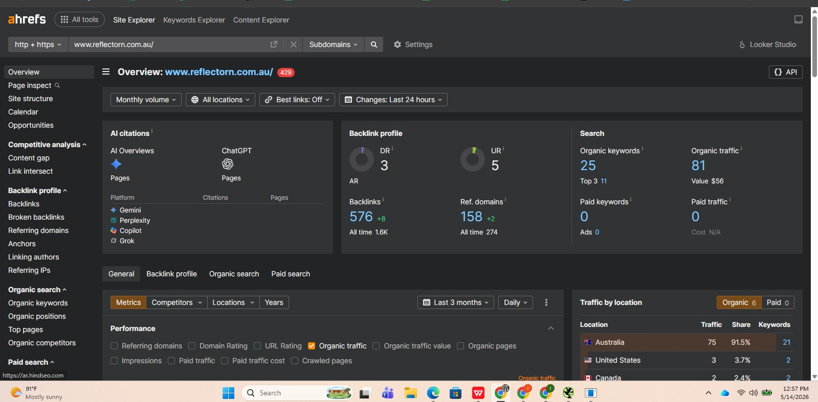
Backlink Profile Overview
Ahrefs domain metrics — May 2026
3
158
576
5
Domain Rating
Referring Domains
Total Backlinks
URL Rating (HP)
Very weak
Moderate volume
Many toxic
Weak homepage
ReflectorN SEO Audit | May 2026
Backlinks
24

Slide 25
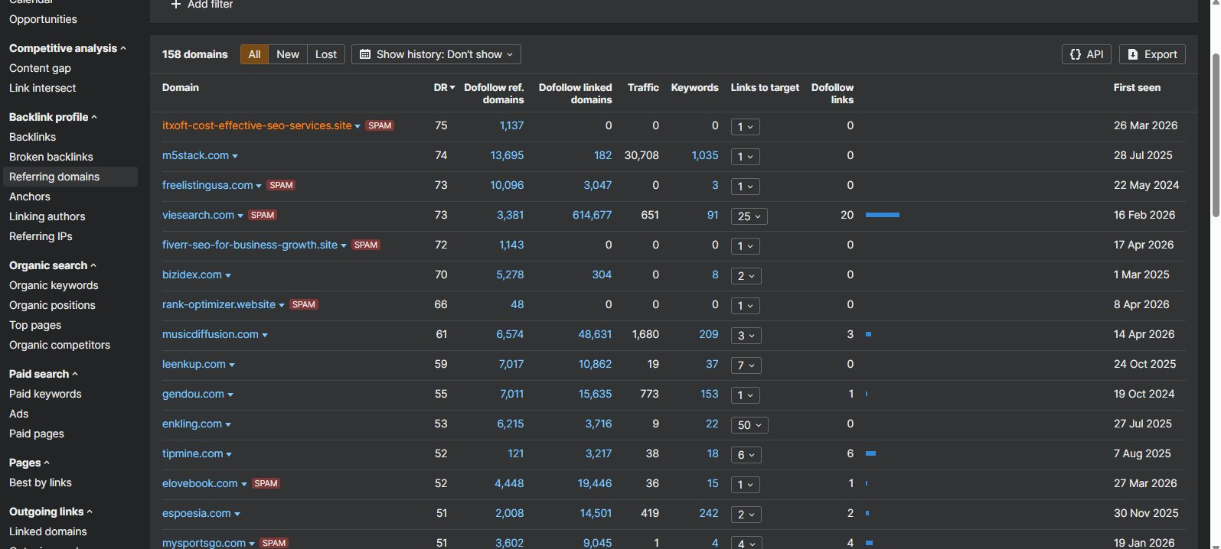
🚨 Toxic Backlink Discovery
Spam-flagged domains making up a large share of the link profile
CRITICAL
PBN-Style Footprint
Ahrefs has flagged dozens of referring domains as SPAM, including:
itxoft-cost-effective-seo-services.site
fiverr-seo-for-business-growth.site
rank-optimizer.website
freelistingusa.com, viesearch.com
elovebook.com, mysportsgo.com
The domain names alone reveal the pattern — fake "SEO services" PBNs.
CRITICAL ACTION
Compile a complete disavow .txt file of all spam-flagged domains. Submit via Google Search Console as soon as access is set up.
ReflectorN SEO Audit | May 2026
Backlinks
25

Slide 26
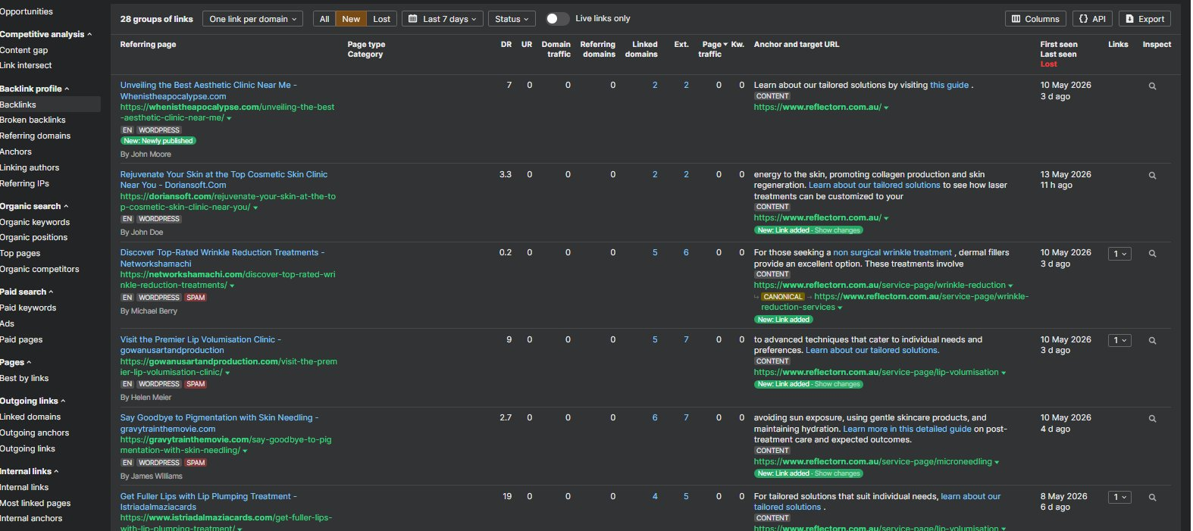
New Backlinks (Last 7 Days)
28 new links — all matching the same suspicious pattern
CRITICAL
The Telltale Signs
All new links share:
Identical anchor text: "learn about our tailored solutions", "this guide"
Low DR (0-9) sites with no cosmetic/beauty relevance
WordPress + generic templates
Random "authors" (Helen Meier, James Williams)
Some sites flagged SPAM by AhrefsThis is either active PBN building or negative SEO — either way it must be addressed.
ReflectorN SEO Audit | May 2026
Backlinks
26

Slide 27
Disavow File Strategy
How to clean the backlink profile safely
1
2
3
4
Export
Filter
Format
Submit
Pull complete backlink list from Ahrefs (also cross-check Semrush + GSC once enabled).
Identify all domains with: (a) SPAM flag, (b) DR ≤ 10, (c) zero topical relevance, (d) identical anchor patterns.
Create disavow.txt with one domain per line in the format: domain:badsite.com
Upload via Google Search Console Disavow Tool. Monitor for 4-8 weeks for ranking recovery.
EXPECTED OUTCOME
Within 6-12 weeks of disavow submission: protection from manual action / Penguin algorithmic penalty, gradual recovery of authority signals, cleaner foundation for future link building.
ReflectorN SEO Audit | May 2026
Backlinks
27

Slide 28
SECTION 08
Keywords & Rankings
Where you rank and where the opportunities lie
ReflectorN SEO Audit | May 2026
KEYWORDS & RANKINGS
28

Slide 29
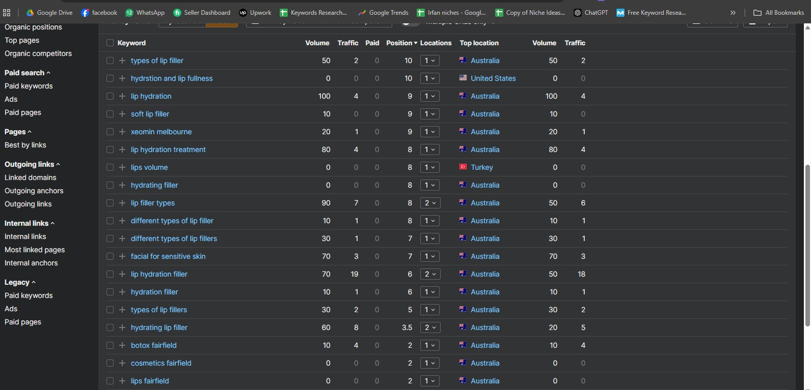
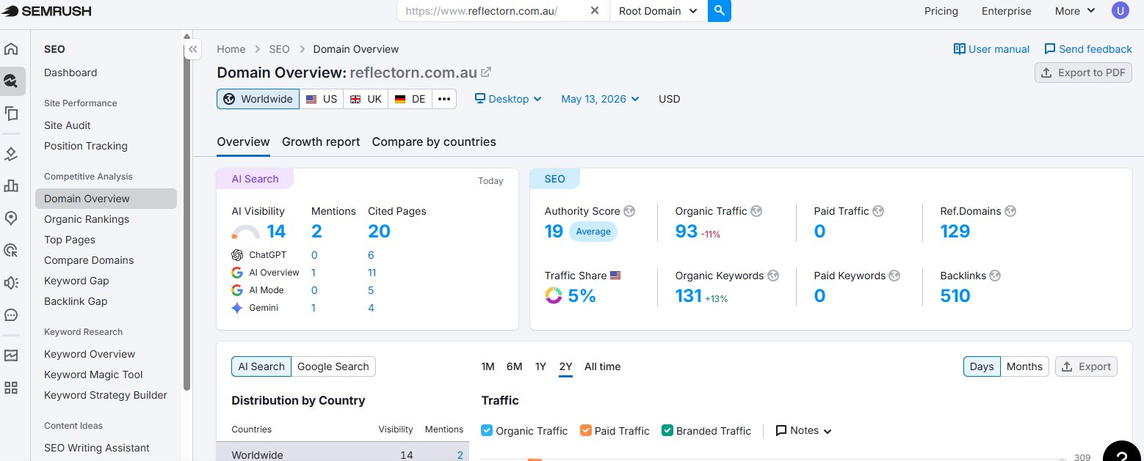
Organic Keyword Performance
Cross-validated via Ahrefs and SEMrush
AHREFS DATA
SEMRUSH DATA
ReflectorN SEO Audit | May 2026
Keywords & Rankings
29

Slide 30
Quick-Win Keyword Opportunities
Already ranking on page 1 — small push gets to top 3
Keyword | Volume | Current Pos | Quick-Win Target | Effort
lip hydration filler | 70 | 6 | Position 1-3 | Medium
hydrating lip filler | 60 | 3.5 | Position 1-2 | Low
lip filler types | 90 | 8 | Position 1-5 | Medium
lip hydration treatment | 80 | 8 | Position 1-5 | Medium
facial for sensitive skin | 70 | 7 | Position 1-5 | Medium
different types of lip fillers | 30 | 7 | Position 1-3 | Low
botox fairfield | 10 | 2 | Position 1 | Low
lips fairfield | 0 | 2 | Position 1 | Low
cosmetics fairfield | 0 | 2 | Position 1 | Low
STRATEGY: Focus on the 4 lip-filler keywords first — they share intent and can be served by strengthening the existing top-traffic post with internal links from new content.
ReflectorN SEO Audit | May 2026
Keywords & Rankings
30

Slide 31
SECTION 09
Local SEO
Google Business Profile, citations & schema markup
ReflectorN SEO Audit | May 2026
LOCAL SEO
31

Slide 32
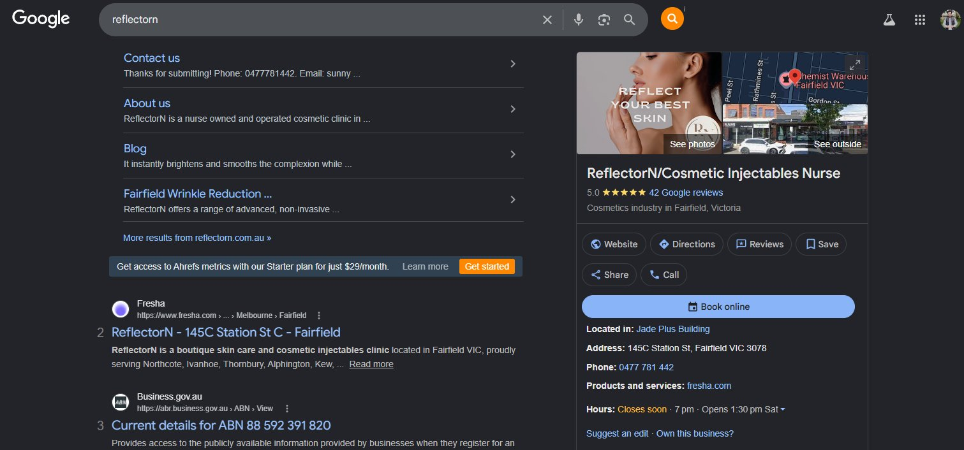
Google Business Profile
Strong local presence — this is the site's biggest asset
PASSING
GBP Status: Excellent ✓
Business Name: ReflectorN / Cosmetic Injectables Nurse
Rating: 5.0 ★ (42 Google reviews)
Category: Cosmetics industry
Address: 145C Station St, Fairfield VIC 3078
Phone: 0477 781 442
Booking: Fresha integration (Book online button)
Photos: Present (interior + branded creative)
KEEP DOING
Continue collecting reviews. Post weekly updates. Add Q&A.
ReflectorN SEO Audit | May 2026
Local SEO
32

Slide 33
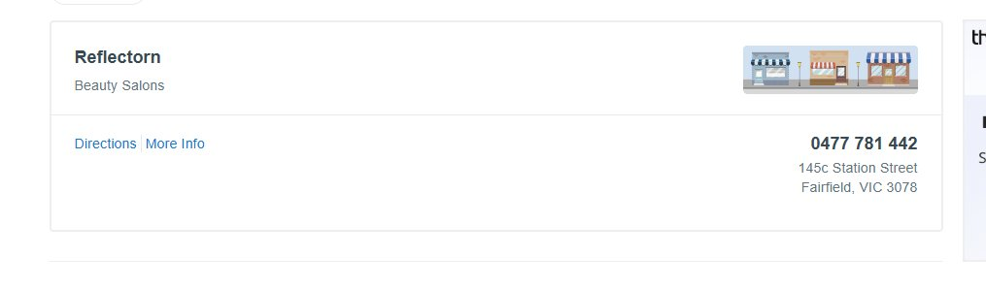
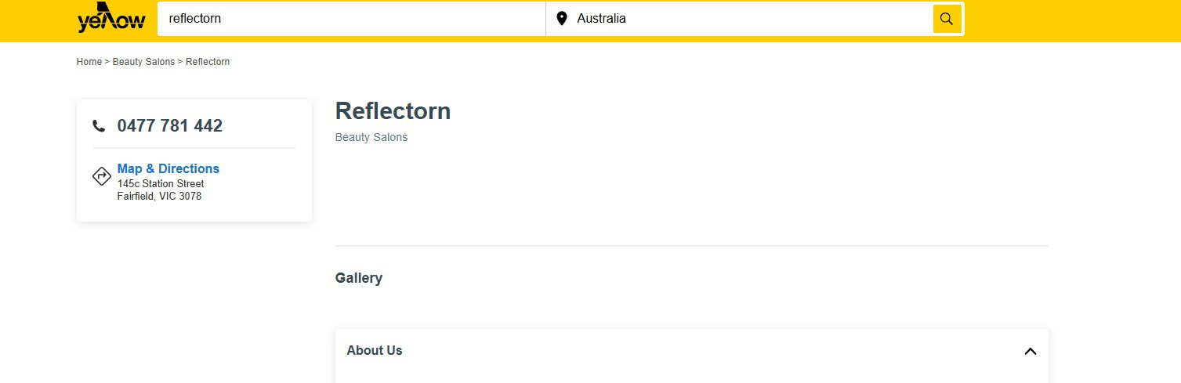
NAP Consistency Across Directories
Name, Address, Phone — citation audit
PASSING
PASSING
TRUELOCAL
YELLOW PAGES
NAP CONSISTENCY CHECK
Source | Name | Address | Phone
Google Business Profile | ReflectorN / Cosmetic Injectables Nurse | 145C Station St, Fairfield VIC 3078 | 0477 781 442
TrueLocal | Reflectorn (Beauty Salons) | 145c Station Street, Fairfield VIC 3078 | 0477 781 442
Yellow Pages | Reflectorn (Beauty Salons) | 145c Station Street, Fairfield VIC 3078 | 0477 781 442
Website (reflectorn.com.au) | ReflectorN | 145C Station St, Fairfield VIC 3078 | 0477 781 442
ReflectorN SEO Audit | May 2026
Local SEO
33

Slide 34
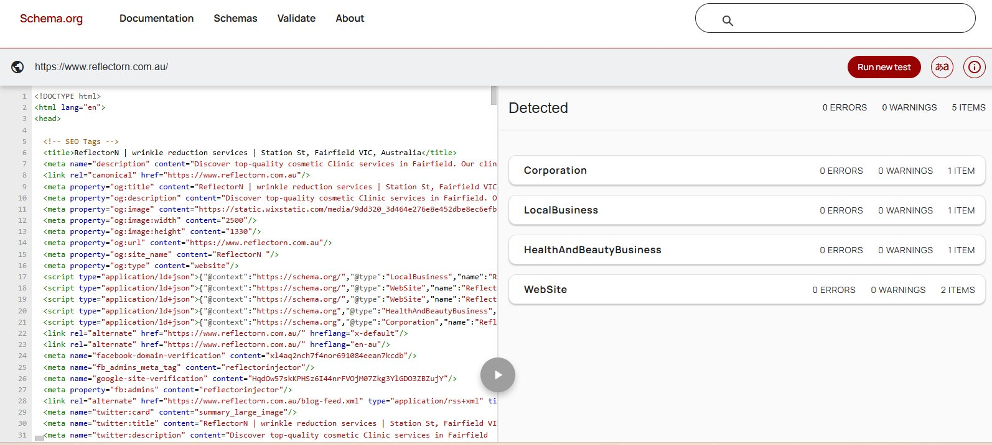
Schema Markup Validation
Structured data check via Schema.org validator
PASSING
Schema Audit: Excellent ✓
5 schema types detected:
Corporation
LocalBusiness
HealthAndBeautyBusiness
WebSite (2 entries)
0 errors, 0 warnings.
Wix has implemented schema correctly for a HealthAndBeauty business.
ENHANCEMENT
Add MedicalBusiness, Review, FAQPage, and Service schema for richer SERPs.
ReflectorN SEO Audit | May 2026
Local SEO
34

Slide 35
SECTION 10
Action Plan
Prioritised 30/60/90 day roadmap
ReflectorN SEO Audit | May 2026
ACTION PLAN
35

Slide 36
30-Day Sprint: Critical Fixes
Immediate priority — stop the bleeding
FIRST 30 DAYS — PROTECT & STABILISE
Priority | Task | Owner | Impact
1 | Compile disavow file from Ahrefs + Semrush. Submit via GSC. | SEO + Client | Penalty protection
2 | Set up Google Search Console + Google Analytics 4 access. | Client | Foundational
3 | Delete all 4 'copy-of' draft pages from Wix dashboard. | Client | Clean indexation
4 | Compress all images >100KB. Convert to WebP. Add alt text. | Designer | Speed +40%
5 | Fix homepage title (78 chars → under 60). | SEO | CTR boost
6 | Fix typos: 'Marrionettes' → 'Marionettes', 'Swich' → 'SWiCH'. | Client | Trust
7 | Add unique meta descriptions to 5 duplicate location pages. | SEO | CTR boost
8 | Verify http → https → www. redirect chain. | Client | Indexation
ReflectorN SEO Audit | May 2026
Action Plan
36

Slide 37
60-Day Phase: Content & Authority
Build E-E-A-T and topical depth
DAYS 31–60 — REBUILD & EXPAND
Priority | Task | Owner | Impact
1 | Rewrite top 5 AI-flagged blog posts with Sunny RN's expertise + practitioner bio. | Content + SEO | Penalty risk -90%
2 | Expand 7 thin pages (Before/Afters, LED, Tear Trough, etc.) to 800+ words. | Content | Commercial rankings
3 | Add author schema to all blog posts (Sunny, RN1). | Developer | E-E-A-T boost
4 | Create proper Service schema for all 12 service pages. | Developer | Rich SERPs
5 | Optimise existing top post — add internal links to related services. | SEO | Diversification
6 | Build 5 new blog posts targeting quick-win keywords (lip filler variations). | Content | Traffic +200%
7 | Set up structured review collection workflow (post-treatment). | Client | GBP signal
8 | Submit XML sitemap + new pages to Google Search Console. | SEO | Indexation speed
ReflectorN SEO Audit | May 2026
Action Plan
37

Slide 38
90-Day Strategy: Scale & Compete
Move from defence to offence
DAYS 61–90 — GROW & COMPETE
Priority | Task | Owner | Impact
1 | Begin manual outreach for high-quality, relevant backlinks (beauty bloggers, AU directories). | SEO | DR boost
2 | Launch Google Posts weekly schedule on GBP (offers, content, photos). | Client | Local rankings
3 | Build dedicated location pages for Northcote, Brunswick, Thornbury (with unique content). | Content + SEO | Local SEO
4 | Create monthly Q&A FAQ content addressing real client questions. | Content | Long-tail traffic
5 | Run quarterly content refresh on top 10 pages — keep them current. | SEO | Ranking maintenance
6 | Develop video content: treatment walkthroughs, before/after journeys. | Content + Client | YouTube + engagement
7 | Competitor monitoring: track 3 main local competitors monthly. | SEO | Strategic insight
8 | Monitor Core Web Vitals in CrUX as traffic grows — react fast. | SEO | Page Experience
ReflectorN SEO Audit | May 2026
Action Plan
38

Slide 39
Expected Impact & Forecast
Conservative projections if action plan is executed
ORGANIC TRAFFIC
ORGANIC KEYWORDS
DOMAIN RATING
Now: 81/mo
Now: 25
Now: 3
350+/mo
120+
15-20
+330% in 6 months
+380% in 6 months
+5x in 6 months
PROJECTED RECOVERY CURVE
ReflectorN SEO Audit | May 2026
Action Plan
39

Slide 40
CONCLUSION
The Path Forward
ReflectorN has a strong foundation — a respected practitioner, glowing reviews, valid schema, and a properly indexed site.
What's holding it back is fixable: AI-generated content, toxic backlinks, heavy images, weak metadata, and thin service pages.
With disciplined execution of the 30/60/90 day plan, organic visibility can multiply 3-4× within six months — converting Sunny's clinical reputation into measurable digital growth.
Thank you
Questions? Get in touch.

